Slide 1
Demo 2 – PinPoint App
Thomas More – 30 nov. 2023

Slide 2
Agenda
Action plan – last demo
Scope
The first design
Navigating the app
User location service
Custom map integration
Next Steps

Slide 3
Action plan last demo
Short term – In progress
Research
Best framework
App or webapp
Optimal localisation methods
Splash screen on app launch

Slide 4
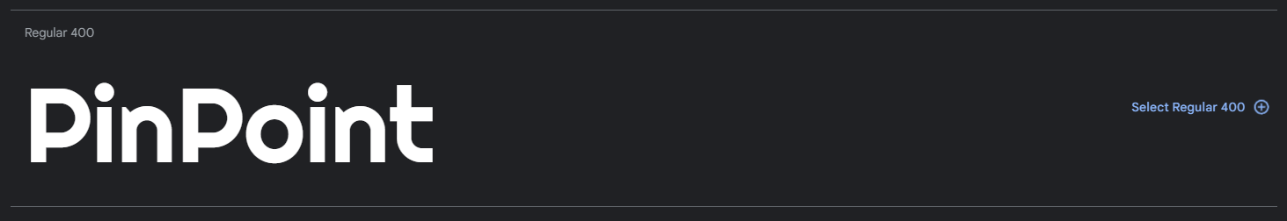


Scope – The first design
Defining your brand
Color palette
Fonts
Splash Screen
Logo
Note – Not permanent, way of implementation is hereby provided

Slide 5
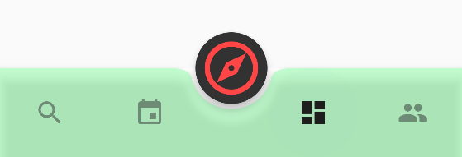
Scope – Navigating the app
With the bottom navigation bar
5 screens
Search Events
My Events
PinPoint
Overview (show on app launch)
Contacts
Active page is highlighted in navbar

Slide 6
Scope – User location service
Finding others
data from user 1
User location data from database
Refreshed every 5 seconds
Longitude & Latitude
Displayable on map
data from user 1 & 2
data from user 2

Slide 7
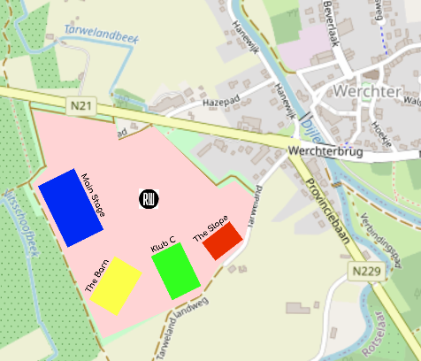
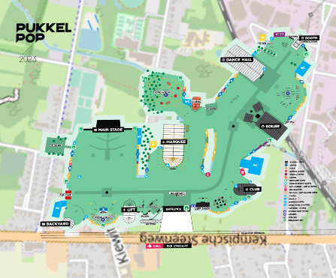
Scope – Custom map integration
For any event
2 options
Create own floorplan (Rock Werchter)
Copy existing one (Pukkelpop)
Displayed on map

Slide 8
Next steps
Short term
Using user location data to display position on map
Sharing location data with others
Using user location to navigate on custom map
= Elaborating on location services

Slide 9
Thank you
Any questions?

